Slide 1
Office of aviation • oaa conference AUGUST 2021
Notes:
Welcome and intro

Slide 2
Office of aviation program updates
James E. Bryant, Administrator

Slide 3
Overview
Ohio Airport Improvement Grant Program
2021 Grant Program Recap
Projects & Status
2022 Grant Program
Funding
Direct Grants – Projects, Status
Matching Grants – General Aviation, Commercial Service
2023 Grant Program

Slide 4
Overview - Continued
Airspace Protection
Inspections
Pavement Condition Index (PCI) Inspections
Airport Compliance & Safety Inspections (5010 Program)
Publications
State Airport System Plan Update
Office Staff

Slide 5
2021 grant program Recap
Total funds allocated to FY2021 Grant Program $5.54 Million
No matching funds for GA or Commercial Airports were allocated since FAA grants were 100%
All partially funded 2020 Projects were funded with 2021 funds and completed
$2.98 Million allocated to complete 2020 projects

Slide 6
2021 grant program RECAP – Direct Grants
11 projects initially awarded in September 2020
4 projects were added in the 4th quarter due to funding being partially restored and 1 project being cancelled
14 Direct Grant projects at 14 airports for 2021 totaling $2.56 Million
Project list available on Aviation Website

Slide 7
2022 grant program
Initial funding available for 2022 Direct Grant Program $6.25 Million
$500,000 held in reserve for any potential matching grants
Secondary award will be made after October 1 for matching grants or additional direct grants

Slide 8
2022 Direct Grant PROGRAM
2022 Direct Grants will be state funded at 95% for all eligible costs, Sponsors share will be 5%
Project awards capped at $500,000 per airport
ODOT received requests for 52 projects totaling $21.8 million at 40 airports
ODOT, Notice of Project Approval, for 25 Projects at 22 airports

Slide 9
ODOT Direct Grant Program
Eligible Projects:
Obstruction Removal and Hazard Lighting – trees, poles, buildings, terrain, etc…
Airfield Marking – Remark Runways, Taxiways and Aprons
Airfield Lighting - Rehabilitation/Replacement of Runway, Taxiway and Apron lighting
Nav-Aids - Rehabilitation/Replacement of Reil’s, PAPI’s, VGSI’s, Beacons, Wind Indicators, Approach Lighting and Automated Weather Observing Systems (AWOS)

Slide 10
ODOT Direct Grant Program (Continued)
Airfield Pavement – Rehabilitation/Resurfacing of Runway, Taxiway and Apron pavements
Items not listed will be considered on a case-by-case basis
Ohio.Airport.Grants@dot.ohio.gov

Slide 11
Grant Cycle for 2022 Direct Grants
Milestone | Date
Grant program announcement letter sent to airport managers and sponsors | March 1, 2021
Deadline to receive applications in Blackcat Aviation | May 1, 2021
Approximate date for Office of Aviation to announce Notices of Project Approval | August 1, 2021
Bids due at Office of Aviation | March 15, 2022
ODOT must encumber FY22 grant funding by June 15, 2022

Slide 12
Matching Grant Program – General Aviation
FY2022 Funds matching FY2021 Federal Funds
Currently 88 Ohio Airports qualify for funding under this program
Funding will match up to a maximum of 5% of the sponsors share of Grants issued under the FAA Airport Improvement Program (AIP)
No matching funds anticipated to be required

Slide 13
Matching Grant Program – Commercial Service
FY2022 Funds matching FY2021 Federal Funds
Eight (8) Ohio Airports currently qualify for funding under this program
Funding will match up to a maximum of 5% of the sponsors share of Grants issued under the FAA Airport Improvement Program (AIP)
The total program value is capped at $500,000
No matching funds anticipated to be required

Slide 14
Grant Cycle for 2022 MATCHING Grants
Milestone | Date
Grant program announcement and letters sent to airport managers and sponsors | October 1, 2021
Deadline to receive applications in Blackcat Aviation | December 31, 2021
Approximate date for Office of Aviation to announce Matching Grant Project List | January 15, 2022
ODOT Target for Matching Grant Awards March 15, 2022

Slide 15
2023 grant program
Recently passed biennial budget included additional funding of $1,000,000 for FY2023
Additional funding will be applied to the Grant Program
Direct and Matching Grant programs expected to continue in FY2023

Slide 16
Grant Cycle for 2023 Direct Grants
Milestone | Date
Grant program announcement letter sent to airport managers and sponsors | March 1, 2022
Deadline to receive applications in Blackcat Aviation | May 1, 2022
Approximate date for Office of Aviation to announce Notices of Project Approval | August 1, 2022
Bids due at Office of Aviation | March 15, 2023
ODOT must encumber FY23 grant funding by June 15, 2023

Slide 17
Airspace protection
ODOT’s jurisdiction for permitting is currently limited to the 6 imaginary surfaces listed in ORC
ODOT partnered with OAA, AOPA, Airport Sponsors and others to re-write portions of ORC 4561 to clarify language that our jurisdiction includes all of the obstruction standards identified in 14 CFR Part 77

Slide 18
Airspace protection
Attempts to adopt the revised language in the biennial budget bill were unsuccessful
ODOT is currently seeking legislators to sponsor the legislation in order to proceed
Information about State and Federal airspace permit requirements still available on our website

Slide 19
AIRPORT INSPECTIONS – Pavement CONDITION (PCI)
Provided as a service by ODOT Office of Aviation at no cost to grant eligible airports
Uses an internationally accepted systematic evaluation method of airport pavements rooted in sound engineering principals
Provides guidance for
Programming pavement maintenance
Phasing of rehabilitation and replacement (lifecycle) needs

Slide 20
AIRPORT INSPECTIONS – Pavement CONDITION (PCI)
This program has
currently evaluated
over 11 million square
yards of airport
pavement in 80
counties throughout
Ohio.

Slide 21
AIRPORT INSPECTIONS – Pavement CONDITION (PCI)
Inspections are typically conducted on a three-year rotating cycle or roughly 33 Airports per year
At the beginning of 2020, Airport Pavement inspections averaged 18 months behind schedule
The Statewide response to the Pandemic has increased our backlog
Inspections will be completed based on availability of staff, contact us with any immediate needs

Slide 22
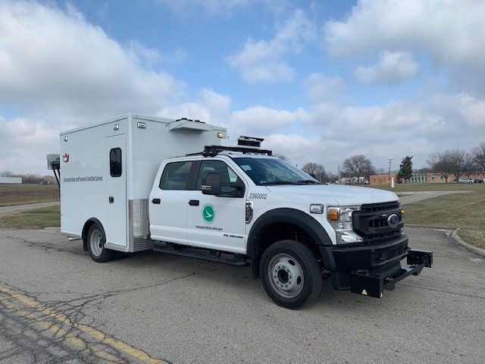
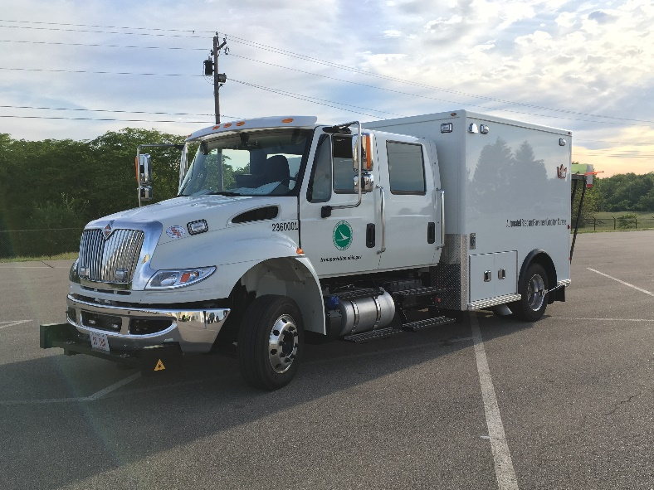
AIRPORT INSPECTIONS – Pavement CONDITION (PCI)
We are introducing our automated data collection vehicles to our options to expedite data collection
We continue
To consider options
To improve our program
PCI Requests can still be made to address a specific pavement area, ie Runway,Taxiway, etc…

Slide 23
Airport inspections - 5010
Airport safety inspections for 2021 are being performed by both Office of Aviation staff and Randy Coller, Aerologic LLC (Contract vendor)
In 2016 100% of the inspections were contracted
ODOT Staff responsible for 39 inspections in 2021, 10 completed by contract
By 2022 and moving forward ODOT staff are expected to complete 100% of inspections

Slide 24
Airport inspections – Common issues
Obstructions
Approach Obstructions - Off Airport
Approach Obstructions - On Airport
Close in obstructions (crops)
Airport Marking
Non-Compliant Safety Areas
Airport Lighting
Pavement Issues

Slide 25
Publications
Ohio Airport Directory and Aeronautical Charts are produced on an alternating annual basis
2021/2022 Ohio Airport Directories are available
Look for an Ohio Aeronautical Chart (with enhanced graphics) for calendar year 2022
Digital copies are always available online
Email requests for hard copies to:
Ohio.Airport.Publications@dot.ohio.gov

Slide 26
Airport System plan update
Mathew Preisler, Airport Planner/Project Manager
Ohio Airport System Plan (OASP)
Matthew.Preisler@dot.ohio.gov
(614) 387-2351

Slide 27
Ohio airport System plan UPDATE
What comprises the Ohio Airport System Plan?
Airport Inventory
Aviation Trends and Issues
Roles and Facility Objectives
Compliance Evaluation
Demand/Capacity Forecasts
Economic Impact Analysis

Slide 28
Ohio airport System plan UPDATE
Why do we need to update the System Plan?
The Ohio Airport System Plan (OASP) was last published in 2014 using data collected in 2012
Updated airport data will also be needed for Ohio’s next LRTP
The OASP will align FAA priorities with identified State and local needs
Project prioritization and funding needs
Identifies Ohio Airports that are eligible for inclusion in the National Plan of Integrated Airport Systems (NPIAS)

Slide 29
Ohio airport System plan UPDATE
What is the current status of the OASP?
ODOT is continuing coordination with the Detroit ADO to secure FY2022 funding
Project Scope and Schedule approved
Preapplication submitted
Project duration expected to be 30-months
Goal is to commence the OASP in early 2022

Slide 30
Ohio airport System plan UPDATE
What sets the proposed OASP apart from other Plans?
The OASP hopes to incorporate an “eComponent” that leverages existing and custom IT systems into an integrated package
The proposed eComponent plans to encompass all System Plan elements and functions
Data gathering
Public outreach
Data dissemination/presentation
Economic impact modeling

Slide 31
Ohio airport System plan UPDATE
A single OASP webpage will provide portals to every feature of the System Plan
Airport sponsors – Data entry and updates (sign in required)
Public – Data queries and report generation
The eComponent will provide the mechanism for airport sponsors to enter/update airport system data directly
The eComponent plans to access published data sets to regularly update the OASP
5010 data
FAA TAF
ODOT CIP data
US Census data

Slide 32
Ohio airport System plan UPDATE
So, what does having the eComponent mean?
The OASP to be continuously updated and result in a “living-document”
The OASP will be transformed from a static document into a live interactive plan
Will provide ease of use through online portals and queries
Will provide for continuous updates in real-time
Elimination of 800+ page paper/pdf document

Slide 33
Ohio airport System plan UPDATE
What are the benefits of the eComponent?
Implementation of the eComponent will provide significant cost savings on all future Ohio Airport System Plan updates
Once developed and in use the OASP will virtually update itself
The eComponent will minimize the need for costly site-visit, data collection, and document development efforts
Net cost estimate difference with the eComponent: $300,000 (proposed OASP versus traditional system plan)

Slide 34
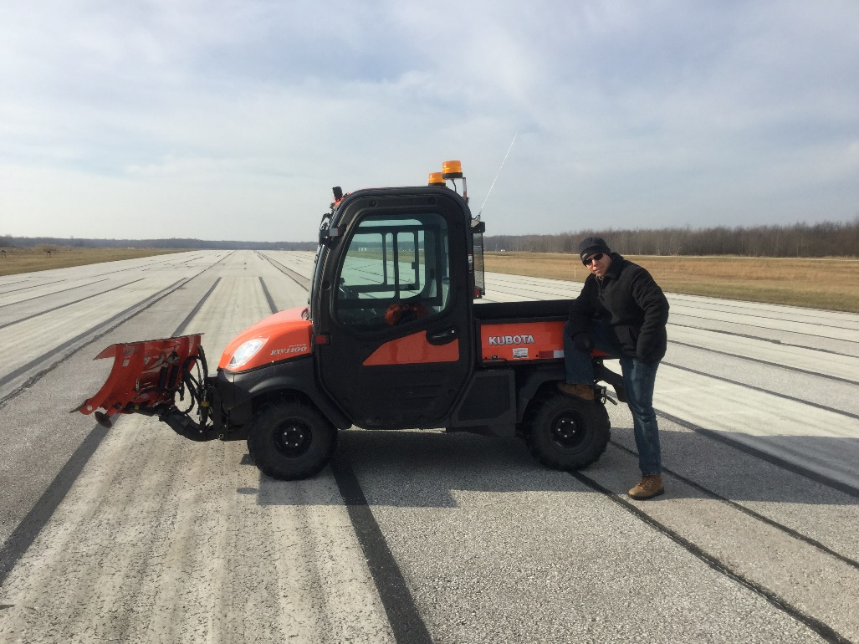
Office of Aviation Staff
John Stains, Engineer
Grants, Inspections, Airspace Protection
John.Stains@dot.ohio.gov
(614) 387-2358

Slide 35
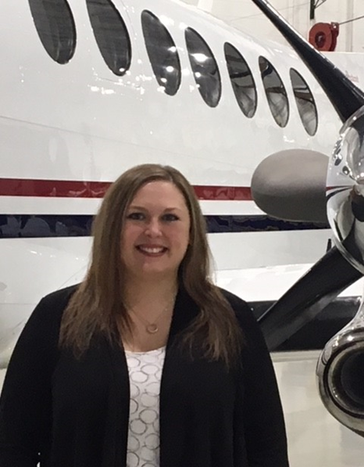
Office of Aviation Staff
Bridget Leesburg, Fiscal Manager
Contracts, Purchase Orders, Pay requests
Bridget.Leesburg@dot.ohio.gov
(614) 387-2383

Slide 36
Office of Aviation Staff
Russell Neice, Project Manager
Grants, Inspections, Airspace Protection,
Blackcat
Russell.Neice@dot.ohio.gov
(614) 387-0928

Slide 37
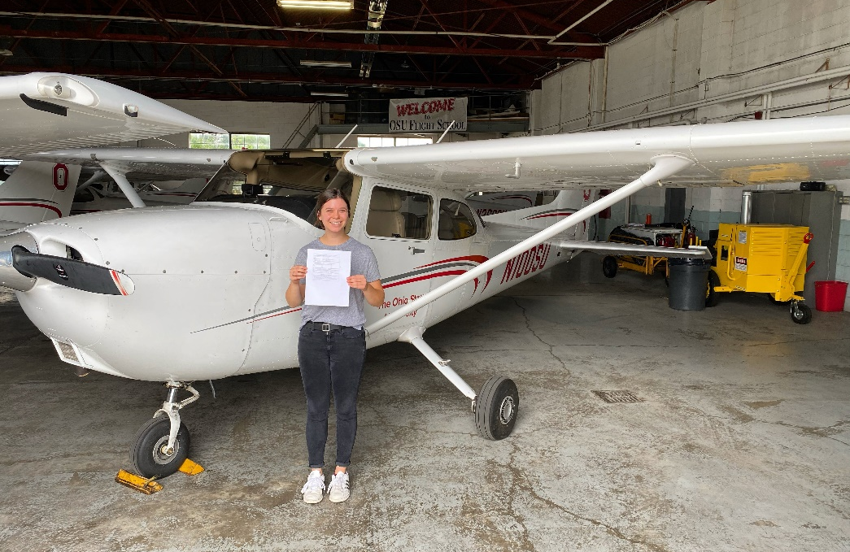
Office of Aviation Staff
Noelle Dzurnak, College Intern
Aviation Engineering, The Ohio State University
Noelle.Dzurnak@dot.ohio.gov
2020 OAA Norman J. Crabtree Memorial Aviation Scholarship Winner

Slide 38
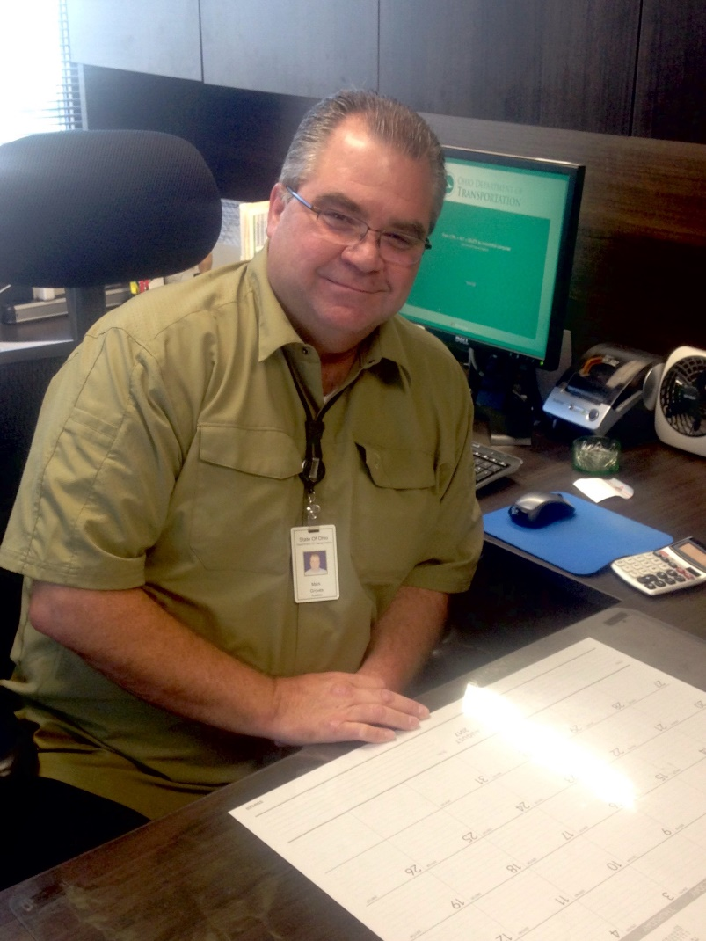
Office of Aviation Staff
Mark Groves, Aviator
5010 Inspections
Mark.Groves@dot.ohio.gov
(614) 387-2313

Slide 39
Office of Aviation Staff
George Poulos, Flight Operations Scheduler
Publications, Pay Requests,
Airport/Aircraft Registration
George.Poulos@dot.ohio.gov
(614) 387-2344

Slide 40
Office of Aviation Staff
Mathew Preisler, Airport Planner/Project Manager
Ohio Airport System Plan (OASP)
Matthew.Preisler@dot.ohio.gov
(614) 387-2351

Slide 41
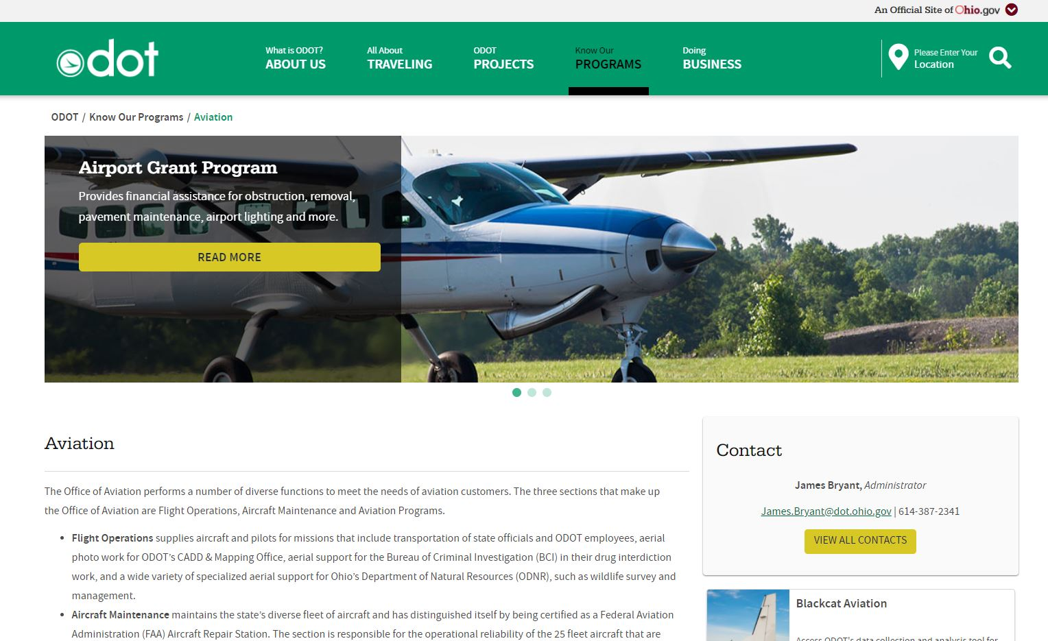
New Website
Office of Aviation website redesign:
https://www.transportation.ohio.gov/wps/portal/gov/odot/programs/aviation/
Check it out and let us know what you think!

Slide 42
Questions
?
Last updated 8/3/2021

